Slide 1


SMART AI 2.0 2026
TITLE PAGE
    Problem Type - Open Innovation
    Problem Statement Title - Making College Data Accessible Through AI-Driven Conversational Intelligence
    Theme - Miscellaneous
    PS Category - Autonomous Multi-Agent Systems
    Team Member - Piyush, Parth, Priyanshu
    Team Name - CAFFINE ADDICTS

Slide 2

🧩 Problem:
    Data scattered across departments (attendance, results, placements)
    Manual searching takes time
    High chances of errors & inconsistency
    No intelligent system for quick insights
    💡 Why It Matters
    Delays in decision-making
    Increased administrative workload
    Poor data utilization
    Need for automation + intelligence in institutions
    🚀 Our Solution
    AI-powered conversational assistant
    Ask questions in natural language
    Get instant, accurate responses
    Works across all institutional data
2
2

Slide 3

TECHNICAL APPROACH
⚡ Key Innovation
    Intent-based query classification
    Simple queries → instant response
    Complex queries → AI Agent Hub
    System decides how to answer
🧠Core Intelligence
    Intent Classifier
    Detects query type
    Routing System
    Simple → Database Engine
    Complex → AI Agent Hub
    Optimized speed + intelligence
🏗️ System Architecture
    Frontend (React Chat UI)
    Backend (FastAPI APIs)
    Intent Classifier Layer
    Database (PostgreSQL)
    AI Layer (Ollama + LLM)
    Vector Search (FAISS)
⚙️ Workflow
    User Query → Classifier →
    (Simple → DB Query)
    (Complex → LLM + FAISS)
🤖 AI Decision Logic
    If query = direct data → SQL
    If query = analytical → LLM
    Role-based filtering (RBAC)
    Context-aware responses
@SIH Idea submission- Template
3
@SIH Idea submission- Template
3
@SIH Idea submission- Template

Slide 4
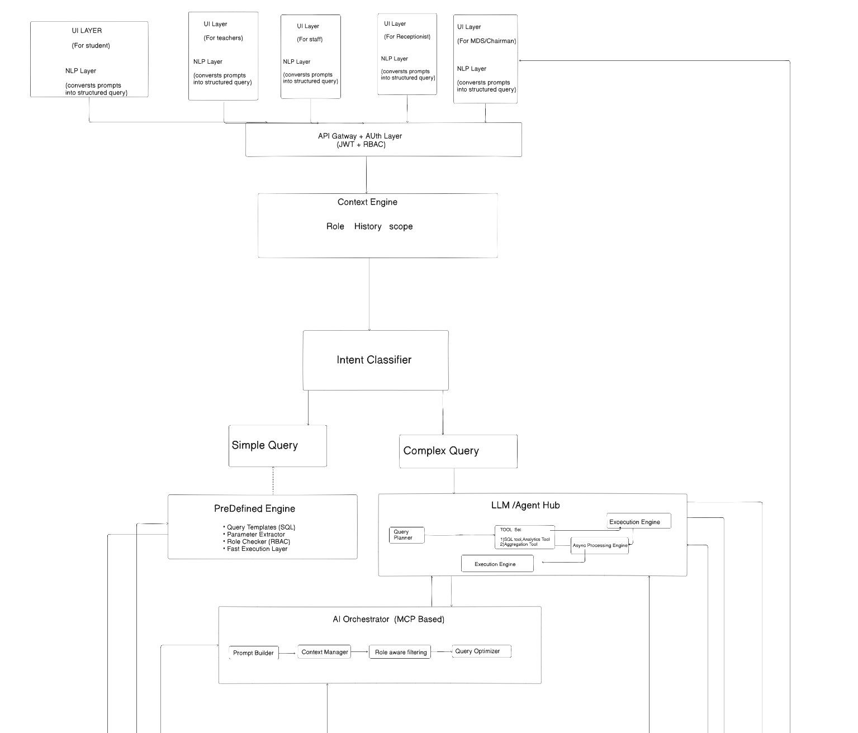
System Design
3
3

Slide 5
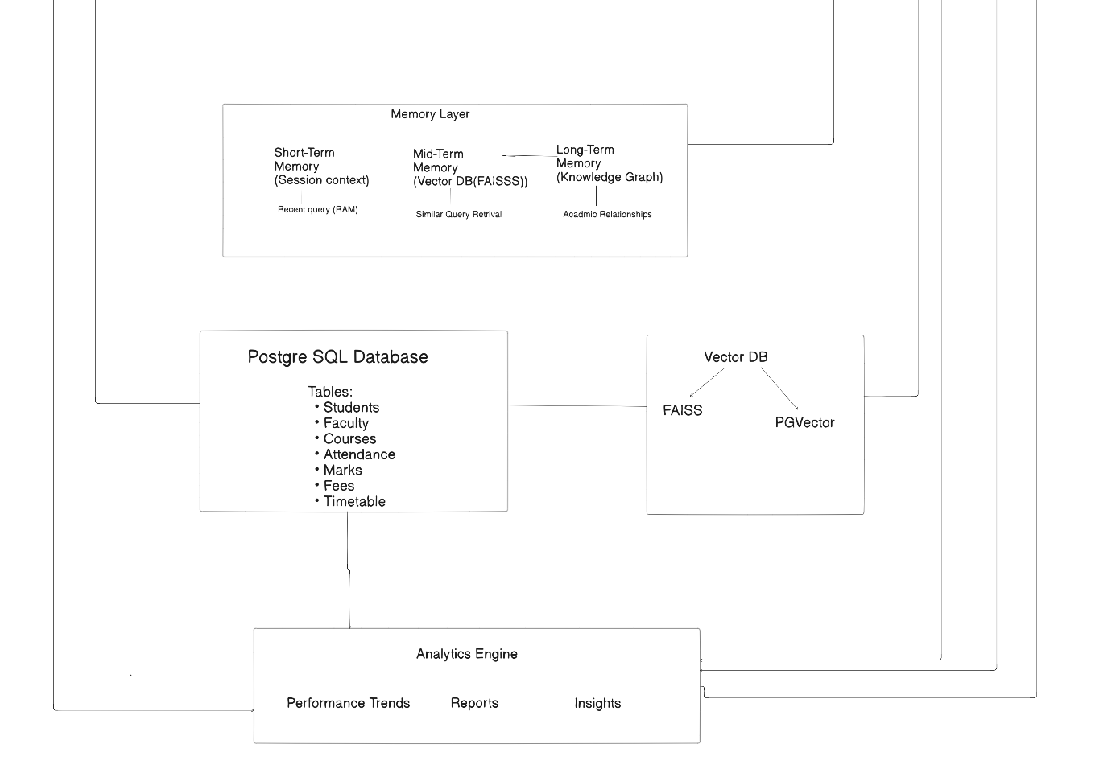
3
3

Slide 6
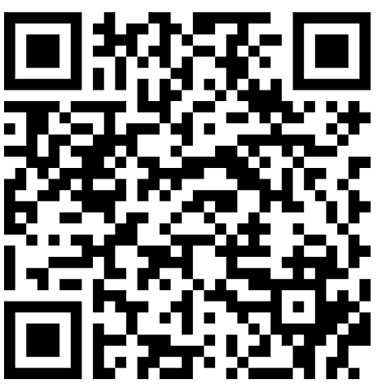
Link for System design
QR For system Design
https://app.eraser.io/workspace/slnqAmryxCtk51O95dFW?origin=share
System Flow
User → API + RBAC → Intent Classifier
→ Simple → Predefined Engine → DB
→ Complex → LLM → MCP → DB
→ Analytics → Response → UI
3
3

Slide 7
WORKING AND USE CASE:
💬 User Query:
“Analyse CSE 3rd year students—show attendance, marks,
identify weak students, and give suggestions.”
📊 Example Use Case:
    Simple Query:
    “Show attendance of CSE 3rd year”
    → Instant DB response
    Complex Query:
    “Find students with low attendance & marks”
    → AI Agent processing
Flow:
📥 Input Query
↓
🧠 Intent Classifier
↓
⚡ DB (Simple Data) + 🤖 AI Agent (Analysis)
↓
📊 Final Output
OUTPUT:
    📊 Attendance + Marks
    ⚠️ At-Risk Students
    💡 AI Suggestions
4
4

Slide 8
IMPACT AND BENEFITS
IMPACT
⚡ Faster data access
📊 Enables Data-Driven Decision Making
🧠 Simplifies Complex Data Handling
🚀Accelerates Digital Transformation in Colleges
⌛Reduces Administrative Delays
BENEFITS
🧠 Smart Decision Support – Converts raw data into actionable insights
🔐 Secure & Personalized Access – Role-based data visibility
🔄 Scalable System : Can expand across departments or institutions
👨‍🏫 Reduces Faculty Workload – Less dependency on manual reporting
🎯 Improves Accuracy – Reduces human errors in data handling
5
5

Slide 9

SYSTEM ARCHITECTURE & FUTURE SCOPE
🔮 Future Vision
    Voice-based AI assistant
    Predictive analytics for students
    Full ERP integration
    Multi-college deployment

